Slide 1
Computer Vision and Image Processing
Prof. André Gustavo Hochuli
gustavo.hochuli@pucpr.br
aghochuli@ppgia.pucpr.br
Notes:
Prof. André Hochuli

Slide 2
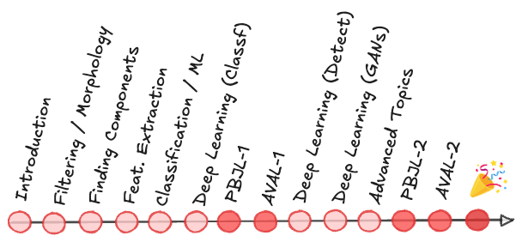
Topics
Apresentação do Professor
O que esperar da disciplina?
Ferramentas do estado da arte
Google Colab
OpenCV
Tensorflow
…..
Exercícios
Computer Vision - Prof. André Hochuli
Lecture 01
Notes:
Prof. André Hochuli

Slide 3
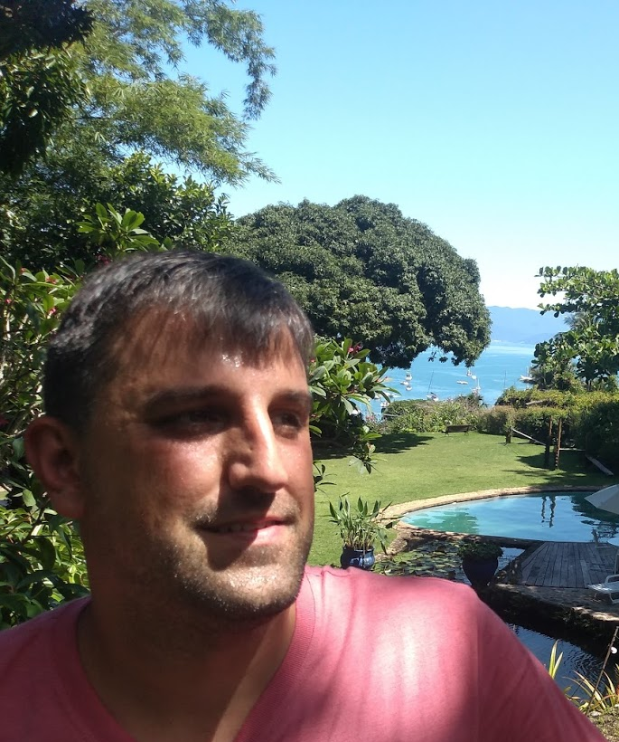
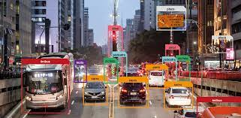

Prof. André Gustavo Hochuli
Formação
Ciência da Computação [2004, PUCPR]
Mestre [2007, PPGIA/PUCPR]
Doutor [2018, PPGINF/UFPR]
Experiência Profissional
P&D em Visão Computacional [2008-2013]
Professor Universitário [2014 – Atual]
Linhas de Pesquisa
Aprendizagem de Máquina e Reconhecimento de Padrões
Hobbies:
Aviação
Futebol
Tecnologia
Computer Vision - Prof. André Hochuli
Lecture 01
Notes:
Prof. André Hochuli

Slide 4
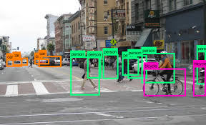
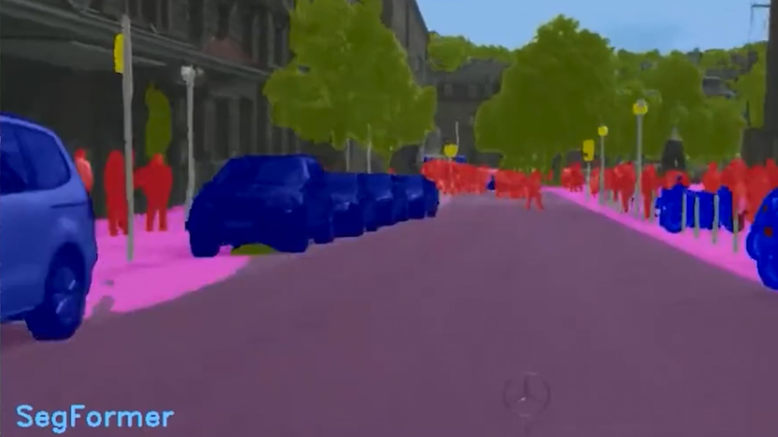
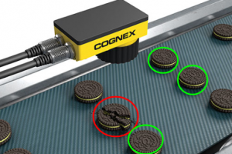
O que esperar da disciplina ?
Processamento de Imagens
Aprendizagem de Máquina
Resolução de problemas
Desafios encontrados no cotidiano
Aulas teóricas e práticas
Espaço para o estudante debater e trazer problemas/dúvidas
Conteúdo incremental
Trabalhos práticos
Provas práticas
OBS: Material didático em língua inglesa.
Computer Vision - Prof. André Hochuli
Lecture 01
Notes:
Prof. André Hochuli

Slide 5
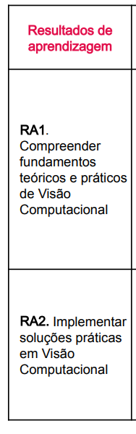
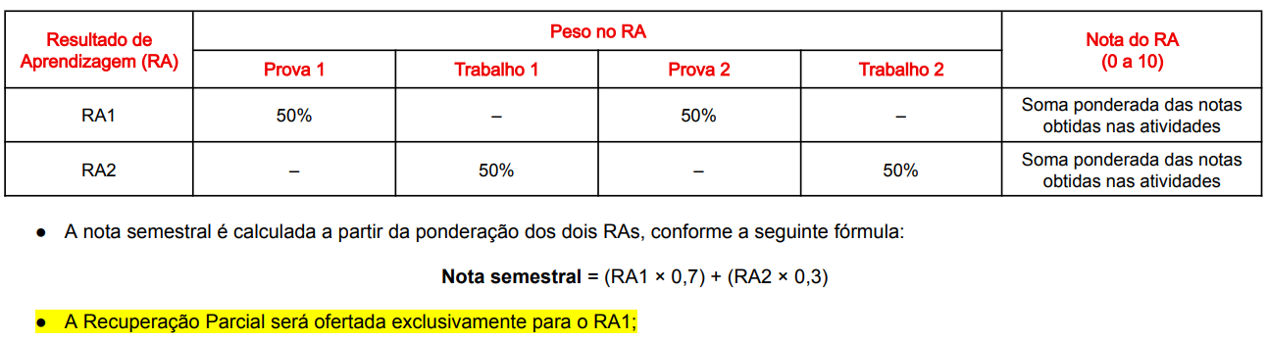
Plano de Ensino (Resumo)
PLANO DE ENSINO COMPLETO DISPONIBILIZADO NO (CANVAS)
Computer Vision - Prof. André Hochuli
Lecture 01
Notes:
Prof. André Hochuli

Slide 6
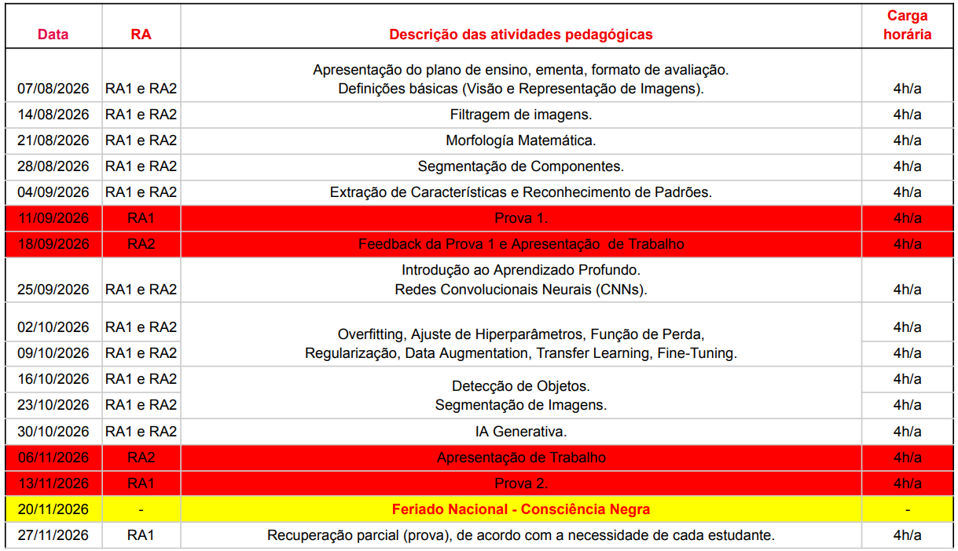
Plano de Ensino (Resumo)
Computer Vision - Prof. André Hochuli
Lecture 01
Notes:
Prof. André Hochuli

Slide 7
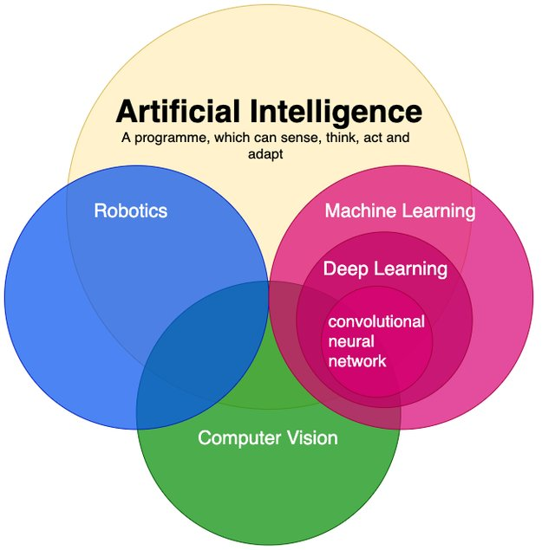
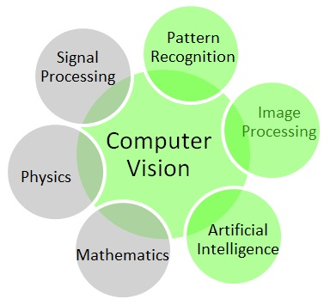
What is Computer Vision (CV) ?
Computer Vision - Prof. André Hochuli
Lecture 01
Notes:
Prof. André Hochuli

Slide 8


Tools & Libraries
Computer Vision - Prof. André Hochuli
Lecture 01
Notes:
Prof. André Hochuli

Slide 9
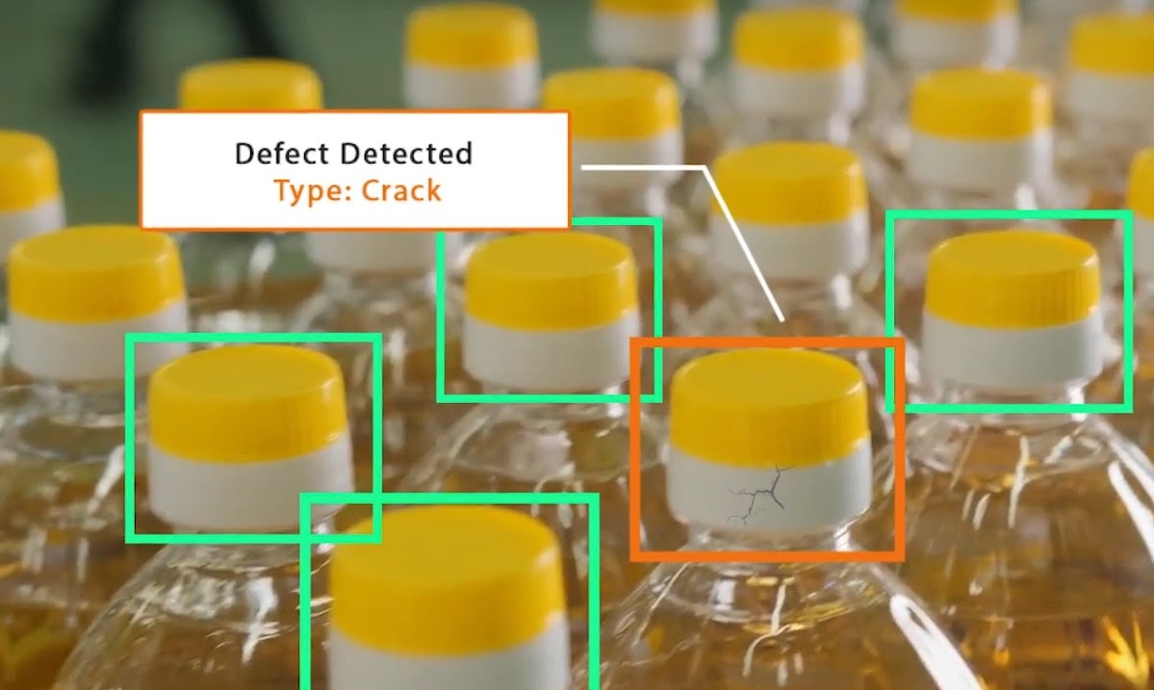
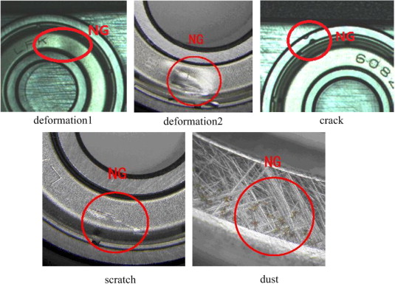
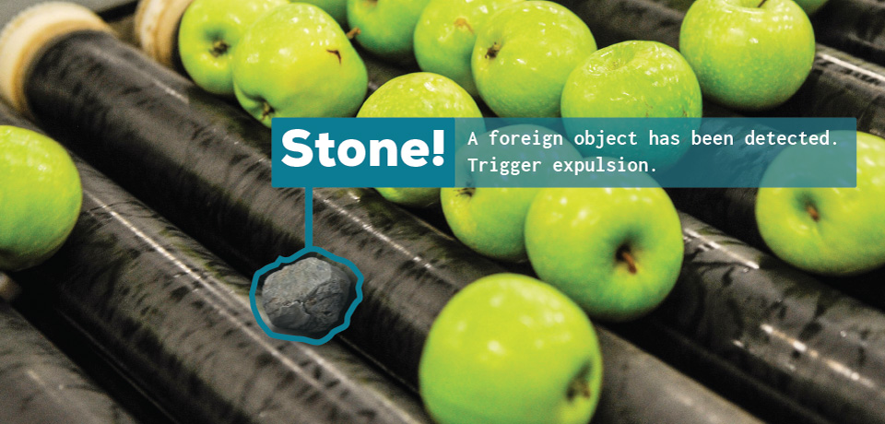
Computer Vision Applications
Defect Detection and Quality Assurance
Computer Vision - Prof. André Hochuli
Lecture 01
Notes:
Prof. André Hochuli

Slide 10
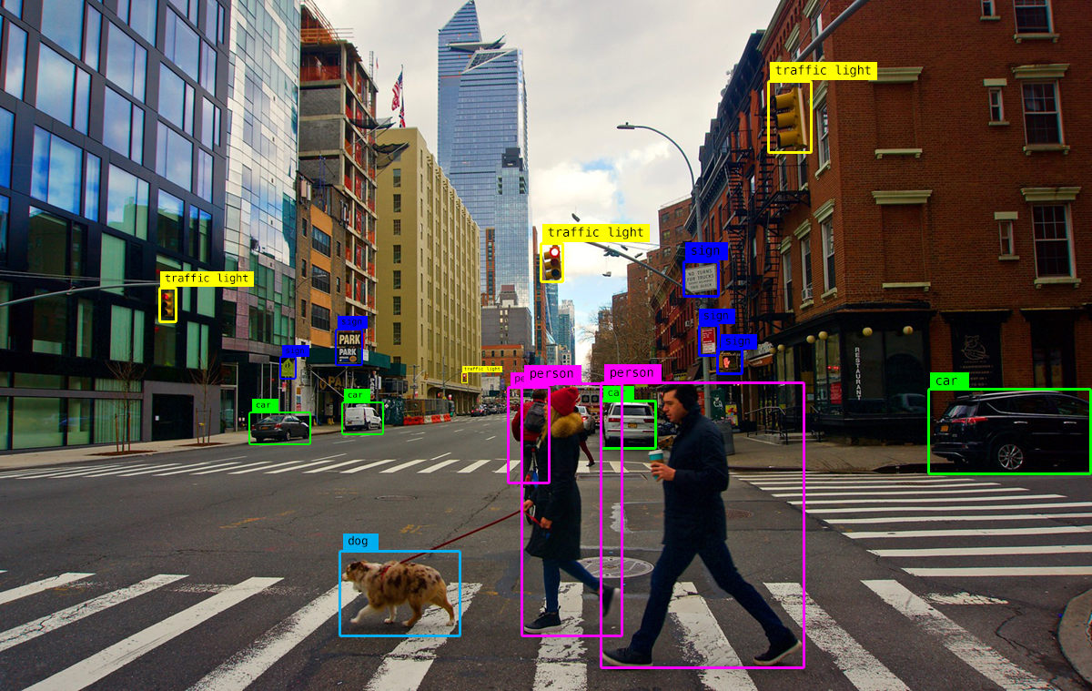
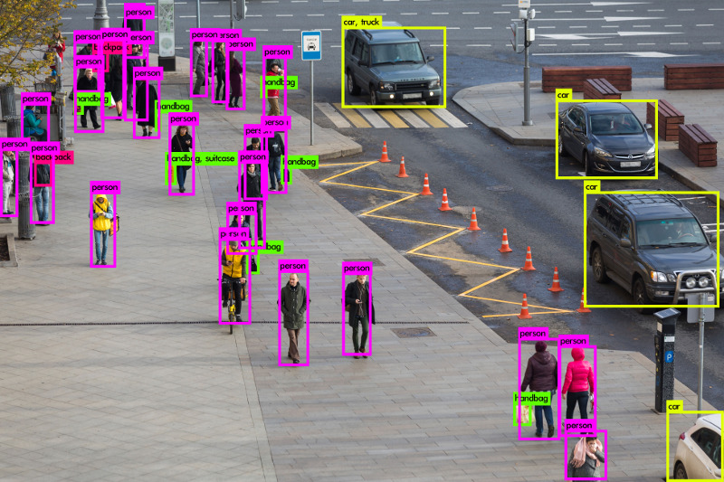
Computer Vision Applications
Video Surveillance and Analytics
Computer Vision - Prof. André Hochuli
Lecture 01
Notes:
Prof. André Hochuli

Slide 11
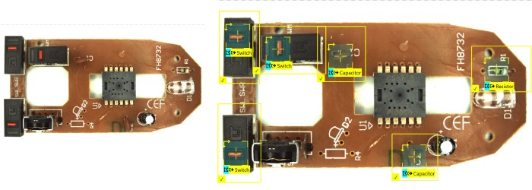
Computer Vision Applications
Assembly Verification
Computer Vision - Prof. André Hochuli
Lecture 01
Notes:
Prof. André Hochuli

Slide 12
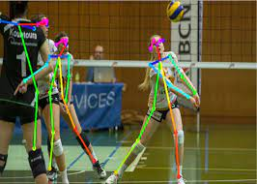
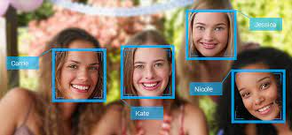
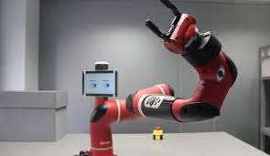
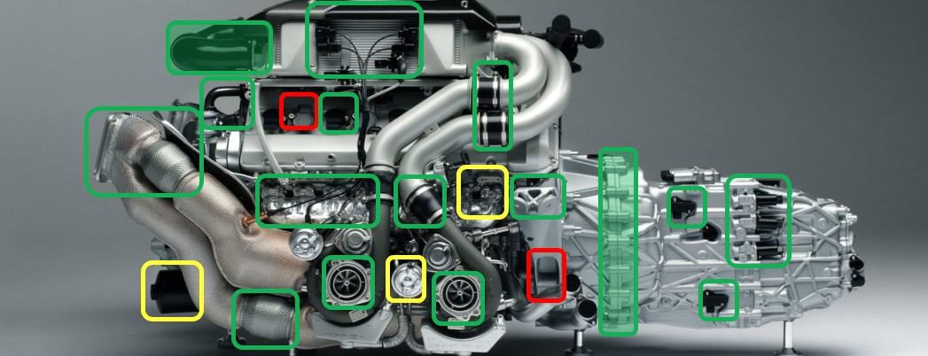
Computer Vision Applications
...and....
Computer Vision - Prof. André Hochuli
Lecture 01
Notes:
Prof. André Hochuli

Slide 13
Jobs
This is a field with several projects and open positions around the world.
Linkedin
Glassdoor
Computer Vision - Prof. André Hochuli
Lecture 01
Notes:
Prof. André Hochuli

Slide 14
Image Processing
Notes:
Prof. André Hochuli

Slide 15
Basic Definitions
Basic Definitions
Pixel, Resolution and Scale
Color Systems
GrayScale, RGB | BGR, CYMK, HSV
Color Conversion
Binarization and Image Filtering
Exercises
Computer Vision - Prof. André Hochuli
Lecture 01
Notes:
Prof. André Hochuli

Slide 16
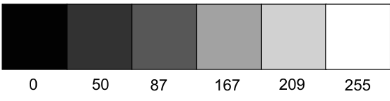
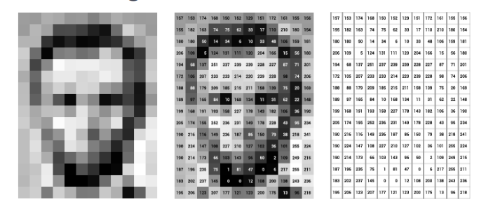
Basic Definitions
Image and Pixel
Image: Matrix NxM
Pixel The smallest information of an image
Range from 0 (black) to 255 (white)
Computer Vision - Prof. André Hochuli
Lecture 01
Notes:
Prof. André Hochuli

Slide 17
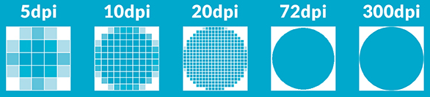
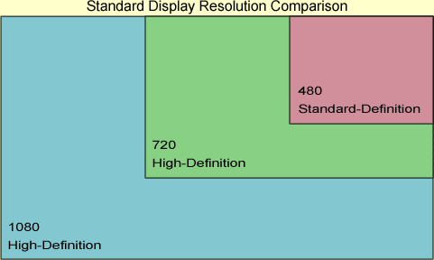
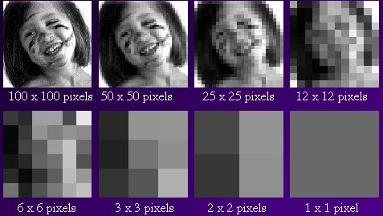
Basic Definitions
Image Resolution
Pixel per Inch (PPI) for digital devices
Dots per Inch (DPI) for analog devices (printers)
Range from 0 (black) to 255 (white)
Computer Vision - Prof. André Hochuli
Lecture 01
Notes:
Prof. André Hochuli

Slide 18

Basic Definitions
What is the problem?
Computer Vision - Prof. André Hochuli
Lecture 01
Notes:
Prof. André Hochuli

Slide 19



Basic Definitions
Downscale and Upscale (Resize)
Resolution loss
Interpolation
96x106
160x200
160x200
Computer Vision - Prof. André Hochuli
Lecture 01
Notes:
Prof. André Hochuli

Slide 20
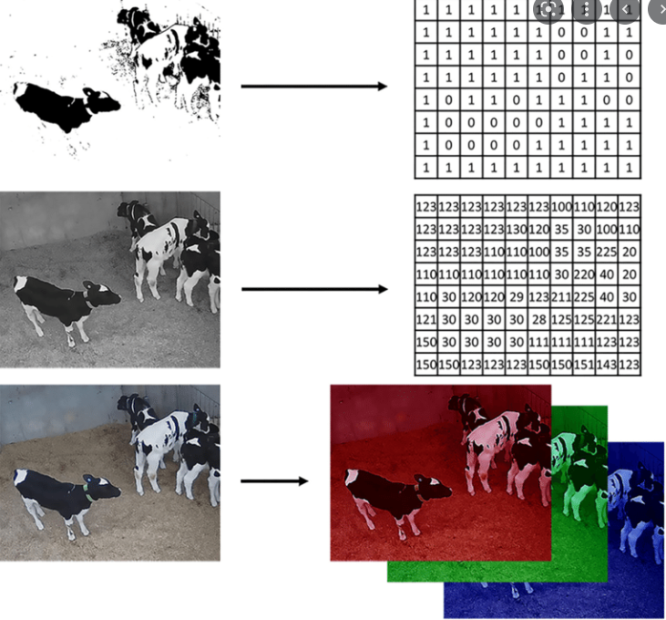
Basic Definitions
ColorSpaces
Binary (0-1) – 1 Channel
GrayScale (0-255) – 1 Channel
Color RGB – 3 Channels
(Red, Green, Blue)Color
Computer Vision - Prof. André Hochuli
Lecture 01
Notes:
Prof. André Hochuli

Slide 21
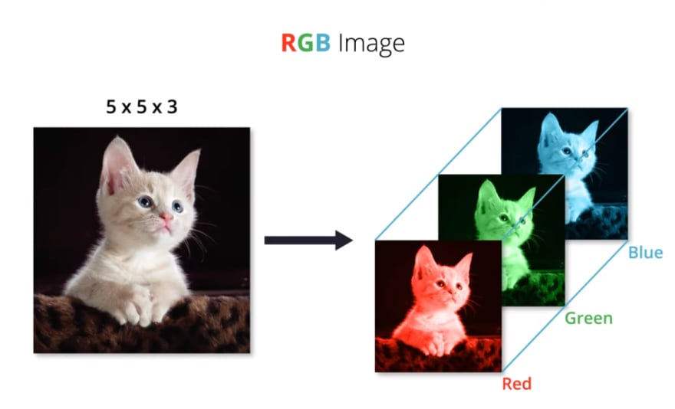
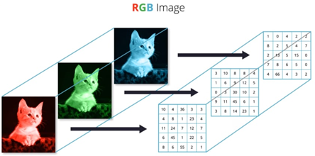
Basic Definitions
Computer Vision - Prof. André Hochuli
Lecture 01
Notes:
Prof. André Hochuli

Slide 22

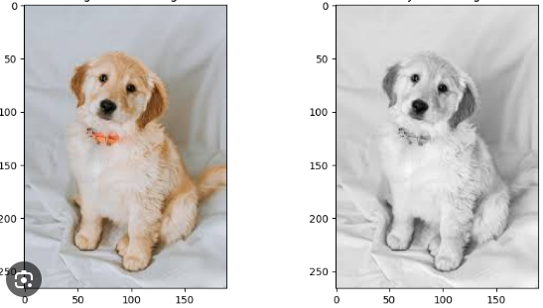
Basic Definitions
From RGB to Grayscale
Computer Vision - Prof. André Hochuli
Lecture 01
Notes:
Prof. André Hochuli

Slide 23
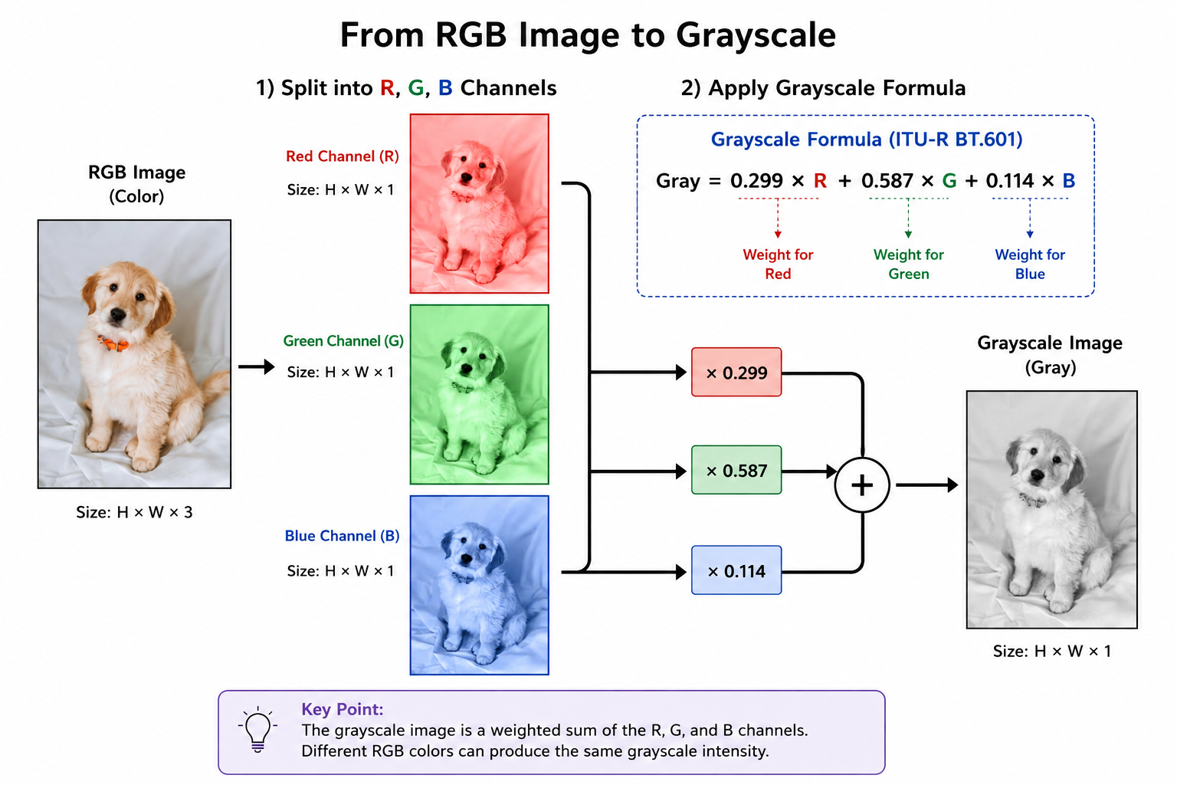
Basic Definitions
From RGB to Grayscale
Computer Vision - Prof. André Hochuli
Lecture 01
Notes:
Prof. André Hochuli

Slide 24
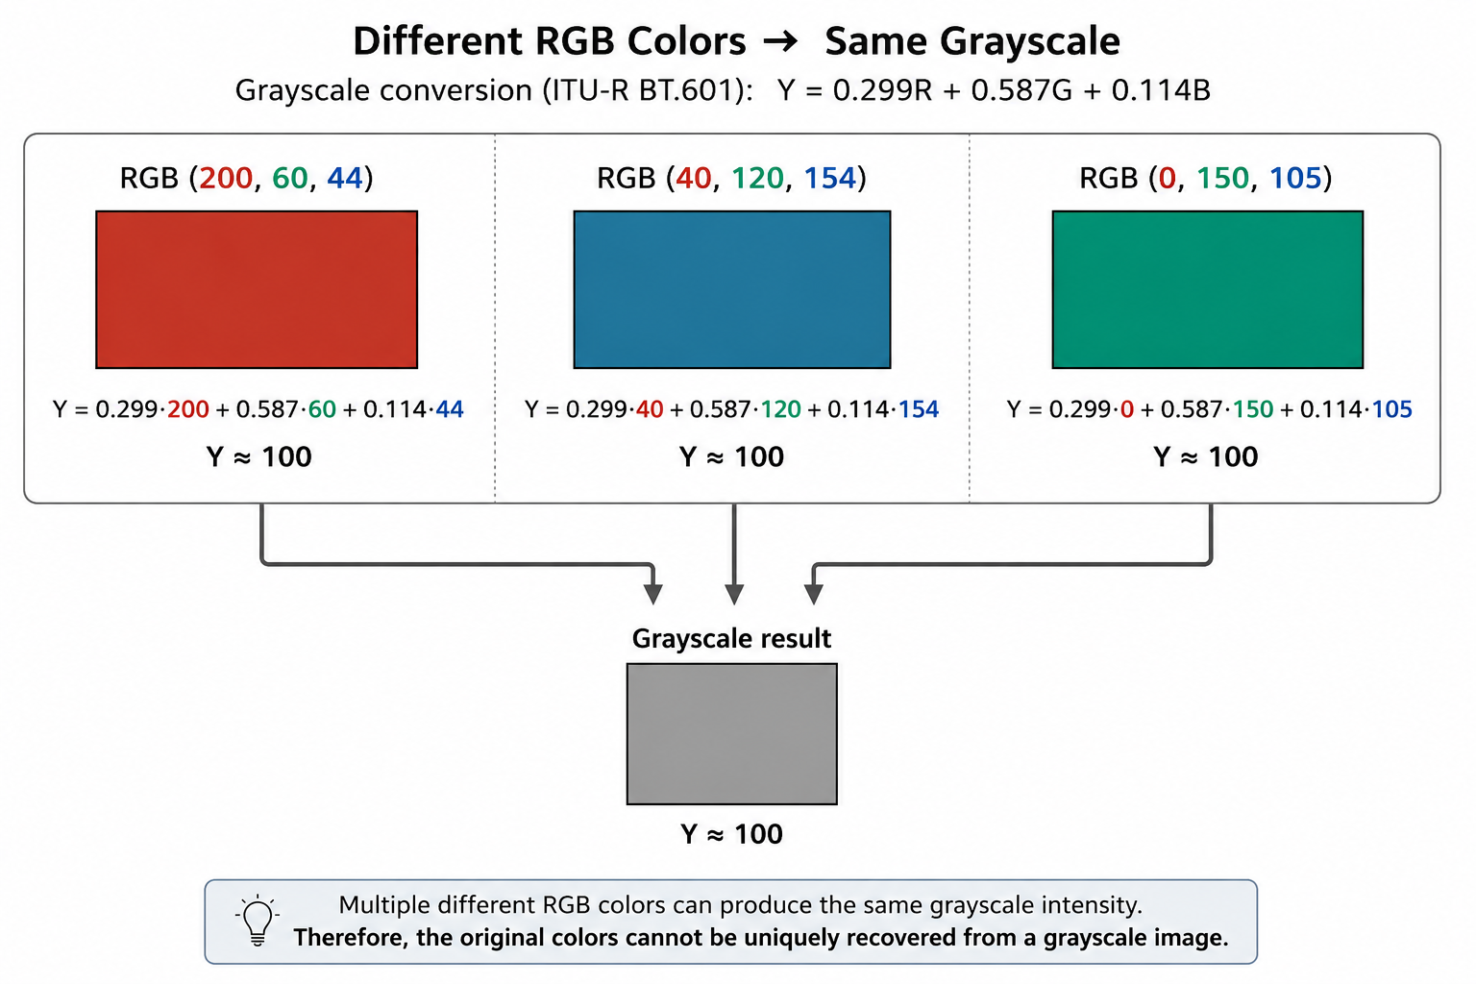
Basic Definitions
From RGB to Grayscale
Computer Vision - Prof. André Hochuli
Lecture 01
Notes:
Prof. André Hochuli

Slide 25
Basic Definitions
Can We Convert Grayscale to RGB?
Computer Vision - Prof. André Hochuli
Lecture 01
Notes:
Prof. André Hochuli

Slide 26
Basic Definitions
Can We Convert Grayscale to RGB?
We can replicate the grayscale channel into the R, G, and B channels to obtain an 3-Channel image, but the original color information is irreversibly lost.
R = G = B
Computer Vision - Prof. André Hochuli
Lecture 01
Notes:
Prof. André Hochuli

Slide 27
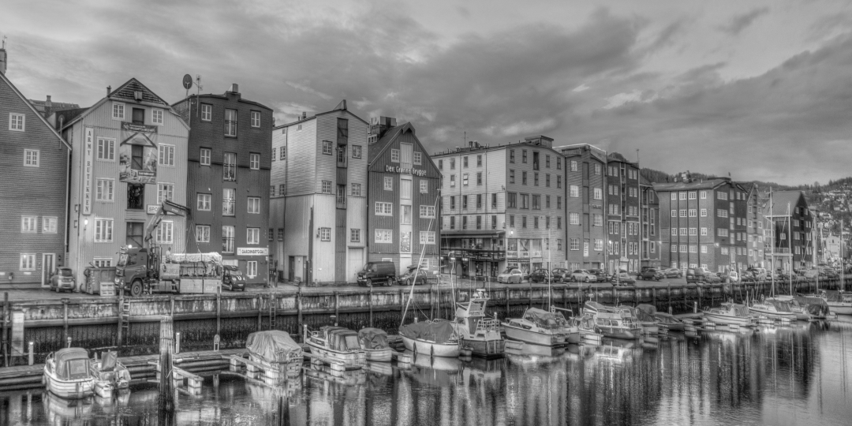
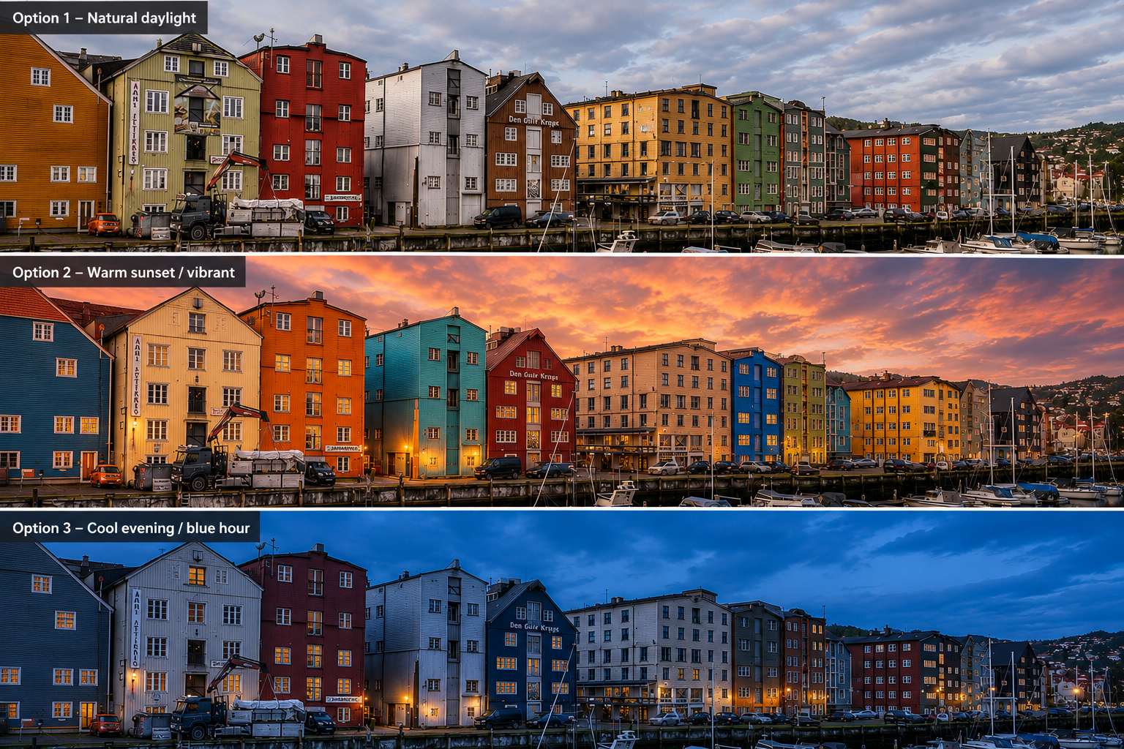
Basic Definitions
Recovering the original colors from a grayscale image is an ill-posed problem:
* Multiple color images can produce the same grayscale image.
* Image colorization algorithms estimate plausible colors rather than recovering the true ones (i.e Generative AI) .
ill-posed problem
Computer Vision - Prof. André Hochuli
Lecture 01
Notes:
Prof. André Hochuli

Slide 28
Basic Definitions
Recovering the original colors from a grayscale image is an ill-posed problem:
* Multiple color images can produce the same grayscale image.
* Image colorization algorithms estimate plausible colors rather than recovering the true ones (i.e Generative AI) .
ill-posed problem
Computer Vision - Prof. André Hochuli
Lecture 01
Notes:
Prof. André Hochuli

Slide 29
Basic Definitions
Recovering the original colors from a grayscale image is an ill-posed problem:
* Multiple color images can produce the same grayscale image.
* Image colorization algorithms estimate plausible colors rather than recovering the true ones (i.e Generative AI) .
ill-posed problem
Computer Vision - Prof. André Hochuli
Lecture 01
Notes:
Prof. André Hochuli

Slide 30
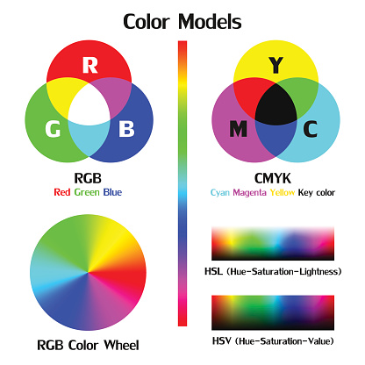
Basic Definitions
Others Color Spaces
Computer Vision - Prof. André Hochuli
Lecture 01
Notes:
Prof. André Hochuli

Slide 31
Practice 01
Let’s Code!!
https://github.com/andrehochuli/teaching/tree/main/ComputerVision
Lecture 01
Computer Vision - Prof. André Hochuli
Lecture 01
Notes:
Prof. André Hochuli

